Slide 1

PYTHON
GROUP 4

Slide 2
what you will learn on python
Variables,
Data types,
Control structures
Lists,
Tuples,
Dictionaries,
Numpy,
Pandas,
Matplotlib and seaborn.
Statistics and probability
Machine learning
Development of django app
Notes:
Variables and Data Types
Title: Variables and Data Types
Content:
Variables: Containers for storing data values.
Example: x = 10, name = "John"
Data Types:
Numeric Types: int, float, complex
Text Type: str
Boolean Type: bool
Collection Types: list, tuple, set, dict

Slide 3
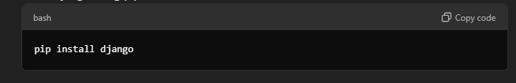
Setup and Environment Configuration
Step 1.1: Install Python and Django
Install Python (recommended: latest stable version).
Install Django using pip:
Notes:
Setup and Environment Configuration
Step 1.1: Install Python and Django
Install Python (recommended: latest stable version).
Install Django using pip:
bash
pip install django
Step 1.2: Create a Virtual Environment
Isolate project dependencies using venv:
bash
python -m venv myenv source myenv/bin/activate # On Windows: myenv\Scripts\activate

Slide 4
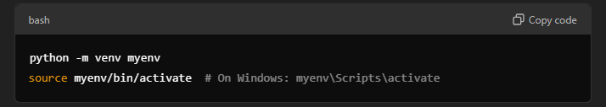
Step 1.2: Create a Virtual Environment
Isolate project dependencies using venv:
Notes:
Variables and Data Types
Title: Variables and Data Types
Content:
Variables: Containers for storing data values.
Example: x = 10, name = "John"
Data Types:
Numeric Types: int, float, complex
Text Type: str
Boolean Type: bool
Collection Types: list, tuple, set, dict

Slide 5
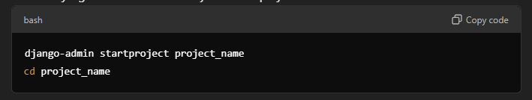
2. Start a Django Project
Step 2.1: Create aNew Project
use the django command-line utility to start a project:
Notes:
Variables and Data Types
Title: Variables and Data Types
Content:
Variables: Containers for storing data values.
Example: x = 10, name = "John"
Data Types:
Numeric Types: int, float, complex
Text Type: str
Boolean Type: bool
Collection Types: list, tuple, set, dict

Slide 6
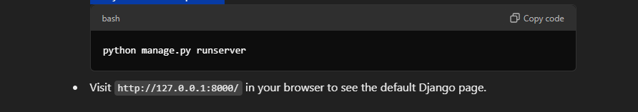
Step 2.2: Run the Development Server
Verify that the setup works
Notes:
Variables and Data Types
Title: Variables and Data Types
Content:
Variables: Containers for storing data values.
Example: x = 10, name = "John"
Data Types:
Numeric Types: int, float, complex
Text Type: str
Boolean Type: bool
Collection Types: list, tuple, set, dict

Slide 7
Notes:
Variables and Data Types
Title: Variables and Data Types
Content:
Variables: Containers for storing data values.
Example: x = 10, name = "John"
Data Types:
Numeric Types: int, float, complex
Text Type: str
Boolean Type: bool
Collection Types: list, tuple, set, dict

Slide 8
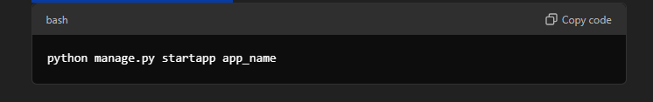
3. Create a Django App
Step 3.1: Generate an App
Create an app within the project:

Slide 9
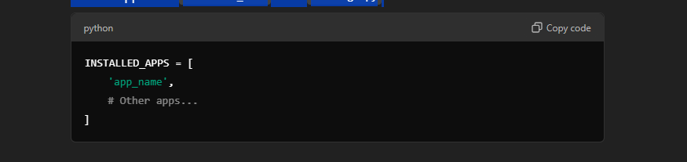
Step 3.2: Register the App
add the app to the INSTALLED_APPS list in settings.py:
Notes:
Variables and Data Types
Title: Variables and Data Types
Content:
Variables: Containers for storing data values.
Example: x = 10, name = "John"
Data Types:
Numeric Types: int, float, complex
Text Type: str
Boolean Type: bool
Collection Types: list, tuple, set, dict

Slide 10
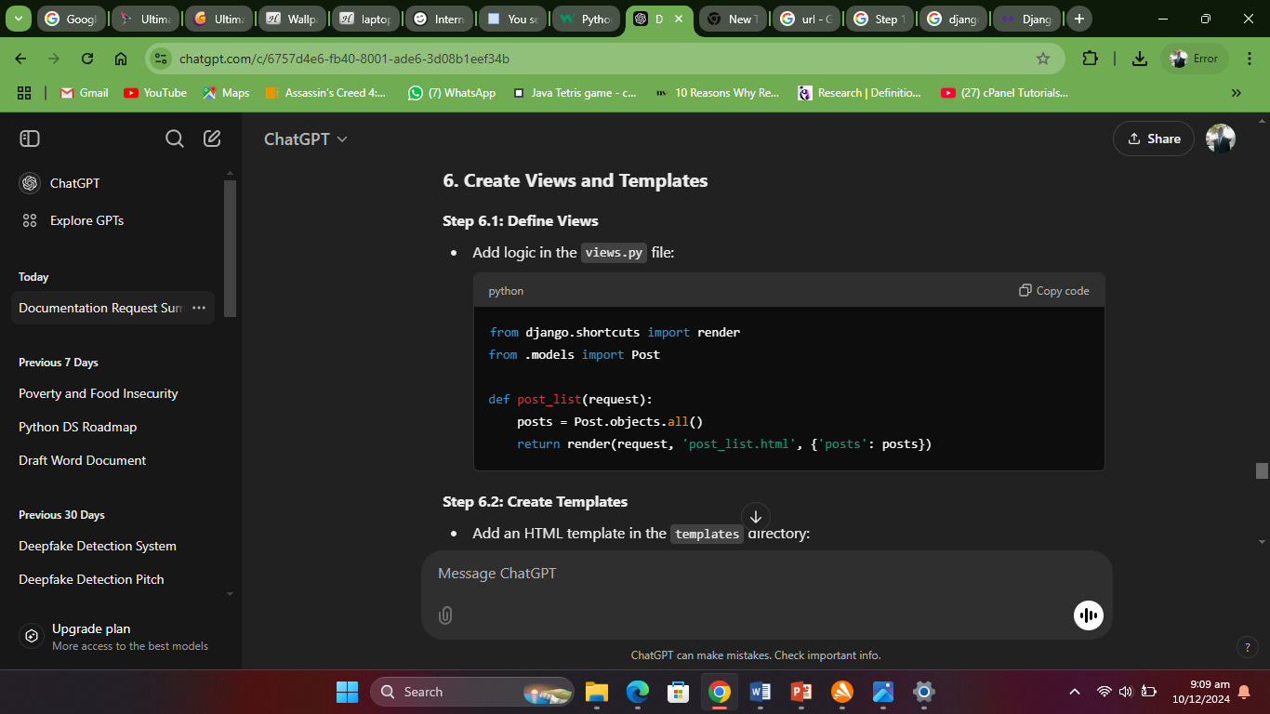
Create Views and Templates
Step 6.1: Define Views
Add logic in the views.py file:
Notes:
Variables and Data Types
Title: Variables and Data Types
Content:
Variables: Containers for storing data values.
Example: x = 10, name = "John"
Data Types:
Numeric Types: int, float, complex
Text Type: str
Boolean Type: bool
Collection Types: list, tuple, set, dict

Slide 11
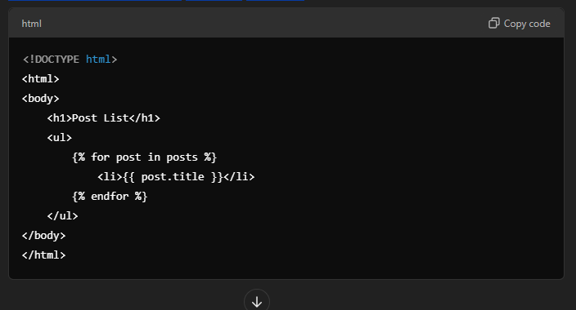
Step 6.2: Create Templates
Notes:
Variables and Data Types
Title: Variables and Data Types
Content:
Variables: Containers for storing data values.
Example: x = 10, name = "John"
Data Types:
Numeric Types: int, float, complex
Text Type: str
Boolean Type: bool
Collection Types: list, tuple, set, dict

Slide 12
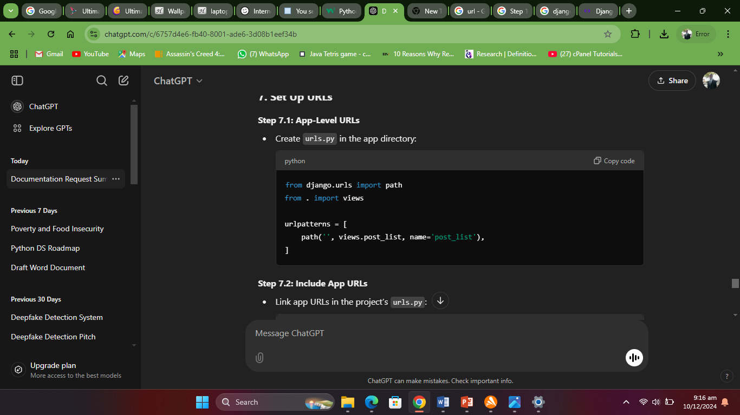
7. Set Up URLs
Step 7.1: App-Level URLs
Create urls.py in the app directory:
python
Notes:
Variables and Data Types
Title: Variables and Data Types
Content:
Variables: Containers for storing data values.
Example: x = 10, name = "John"
Data Types:
Numeric Types: int, float, complex
Text Type: str
Boolean Type: bool
Collection Types: list, tuple, set, dict

Slide 13
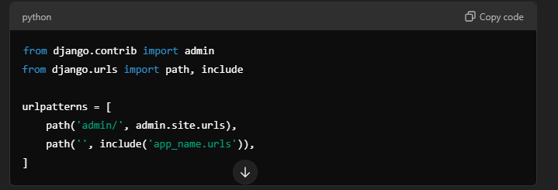
Step 7.2: Include App URLs
Link app URLs in the project’s urls.py
Notes:
Variables and Data Types
Title: Variables and Data Types
Content:
Variables: Containers for storing data values.
Example: x = 10, name = "John"
Data Types:
Numeric Types: int, float, complex
Text Type: str
Boolean Type: bool
Collection Types: list, tuple, set, dict

Slide 14
Learning REsources
Recommended Learning Resources
Books
Online Courses
Forums and Documentation
YouTube Tutorials
Notes:
Variables and Data Types
Title: Variables and Data Types
Content:
Variables: Containers for storing data values.
Example: x = 10, name = "John"
Data Types:
Numeric Types: int, float, complex
Text Type: str
Boolean Type: bool
Collection Types: list, tuple, set, dict

Slide 15
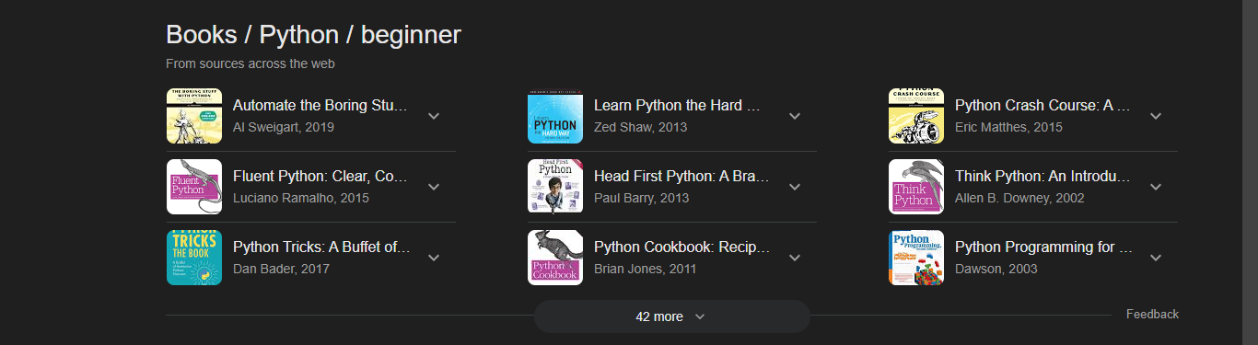
books
Notes:
Variables and Data Types
Title: Variables and Data Types
Content:
Variables: Containers for storing data values.
Example: x = 10, name = "John"
Data Types:
Numeric Types: int, float, complex
Text Type: str
Boolean Type: bool
Collection Types: list, tuple, set, dict

Slide 16
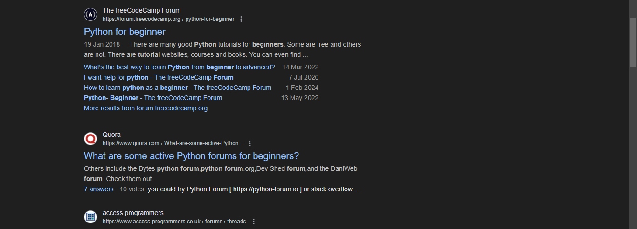
forum
Notes:
Variables and Data Types
Title: Variables and Data Types
Content:
Variables: Containers for storing data values.
Example: x = 10, name = "John"
Data Types:
Numeric Types: int, float, complex
Text Type: str
Boolean Type: bool
Collection Types: list, tuple, set, dict

Slide 17
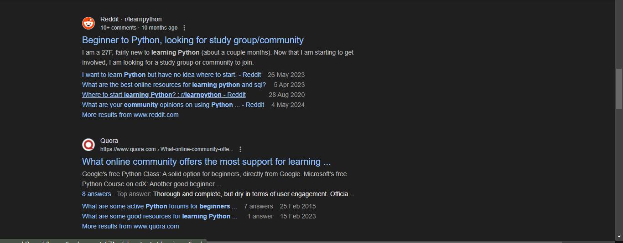
communities
Notes:
Variables and Data Types
Title: Variables and Data Types
Content:
Variables: Containers for storing data values.
Example: x = 10, name = "John"
Data Types:
Numeric Types: int, float, complex
Text Type: str
Boolean Type: bool
Collection Types: list, tuple, set, dict

Slide 18
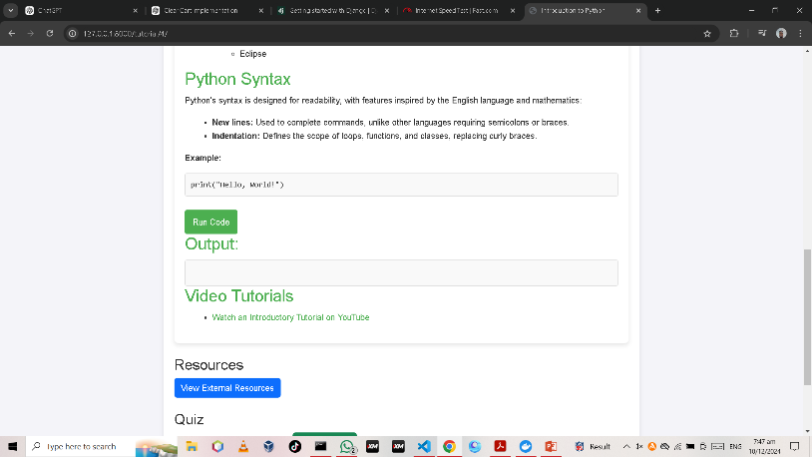
Interactive tutorials

Slide 19
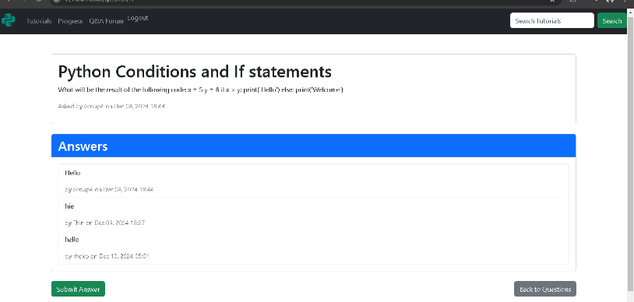
Q&A forum for student interaction.

Slide 20
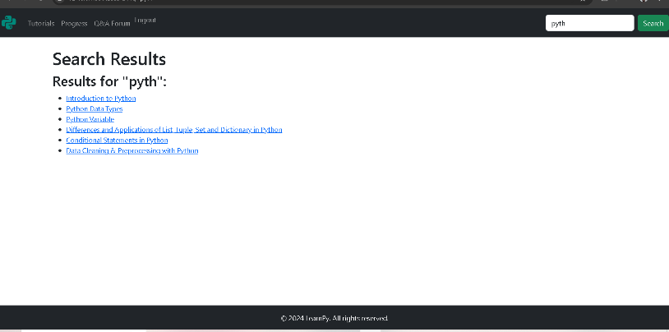
Search functionality for tutorials.

Slide 21
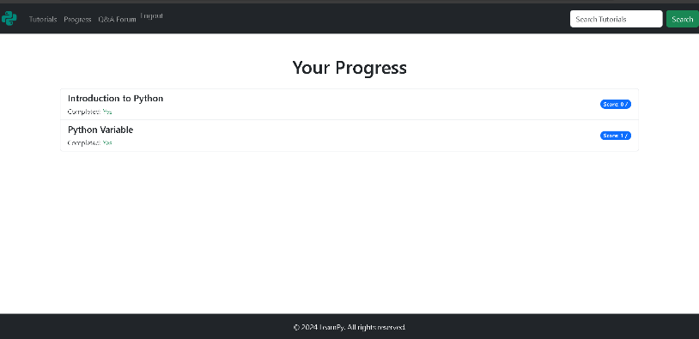
Progress tracking system.

Slide 22
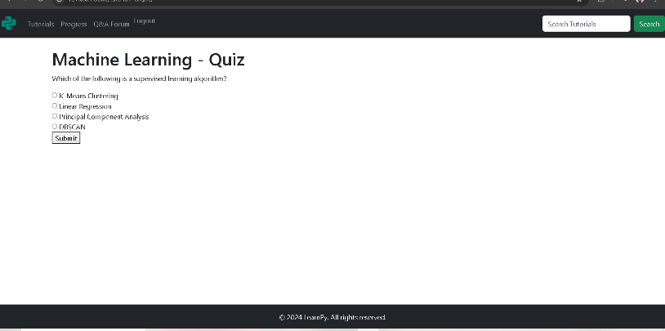
Tutorial quizzes

